Slide 1

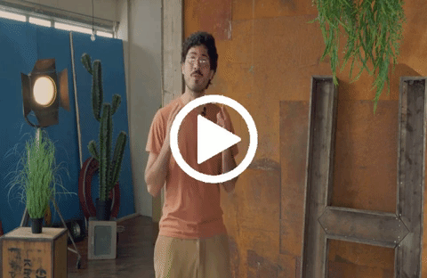
⁉️ How to do the activity
1️⃣ Watch the video for this activity 2️⃣ Who could be your audience? It’s always important to plan your presentation with a clear audience in mind! Think: who in your network can give you valuable feedback on the presentation and your idea? 3️⃣ Next, prepare slide 1 - which is all about you as a person and as a potential entrepreneur. Write the big bullet points in the slide. Write a script in the slide notes so that you know exactly what you want to say in every moment. Replace the placeholder photo with a photo of yourself. 4️⃣ Next, prepare slide 2 - which is all about your idea. Write the big bullet points in the slide. Like on Slide 1, write a script in the slide notes. Replace the placeholder photos with photos that represent your idea; target customers; and big vision. 5️⃣Next, practice the presentation using “Presenter Mode” Whilst you do your test runs, you can record yourself with your smartphone or with this app to watch back and see where you need to improve. Get to know the animations in the slides - and when you present, time the animations according to what you are saying. 6️⃣ Now it is time to present to other people! Find an individual or a group to present and ask for their feedback - both on your idea and on the way you presented. Try to present the information in 5 minutes or less - people like a short introduction to an idea! Remember, you can always make it even better when you get feedback!
💜💙🧡 CONNECT ▶️ link to full series
First, watch the video 🔻 🎯 Goals of this activity: | My Activity Will others believe in my idea? ⏳ This activity will take around 10 hours 💬🗨️ Format: We recommend doing this activity like this: First, fill in the slides & script sections for each slide on your own or with a mentor Next, find someone to present your idea to using the slides and script, and get some feedback.
For you to become confident in presenting your ideas to other people For you to use presentations to get feedback from other people For you to use presentations to get new opportunities to make your idea real | For you to become clearer about your idea For you to be able to tell your story & explain your idea anytime when you meet new people For you to get a visual presentation to make it even easier to show & tell about your idea. For you to practice presentation skills.

Slide 2

Hello! I am
[ENTER YOUR NAME]
About me: My background
Write here a thing that you want to share about yourself in up to two lines.
Write here a thing that you want to share about your professional experience
Write here a thing that you want to share about your professional skills.
Here is what motivates me to start a business:
Write here what motivates you to start a business in one or two sentences.
Notes:
Enter your script in the bullet points below.
Make your audience feel welcome and grab their attention! Say hello, introduce yourself.
Explaining more generally what your background is.
Explain your work experience & what education and training you have received so far.
Explain your skills an
Explain what motivates you to start your own business.

Slide 3
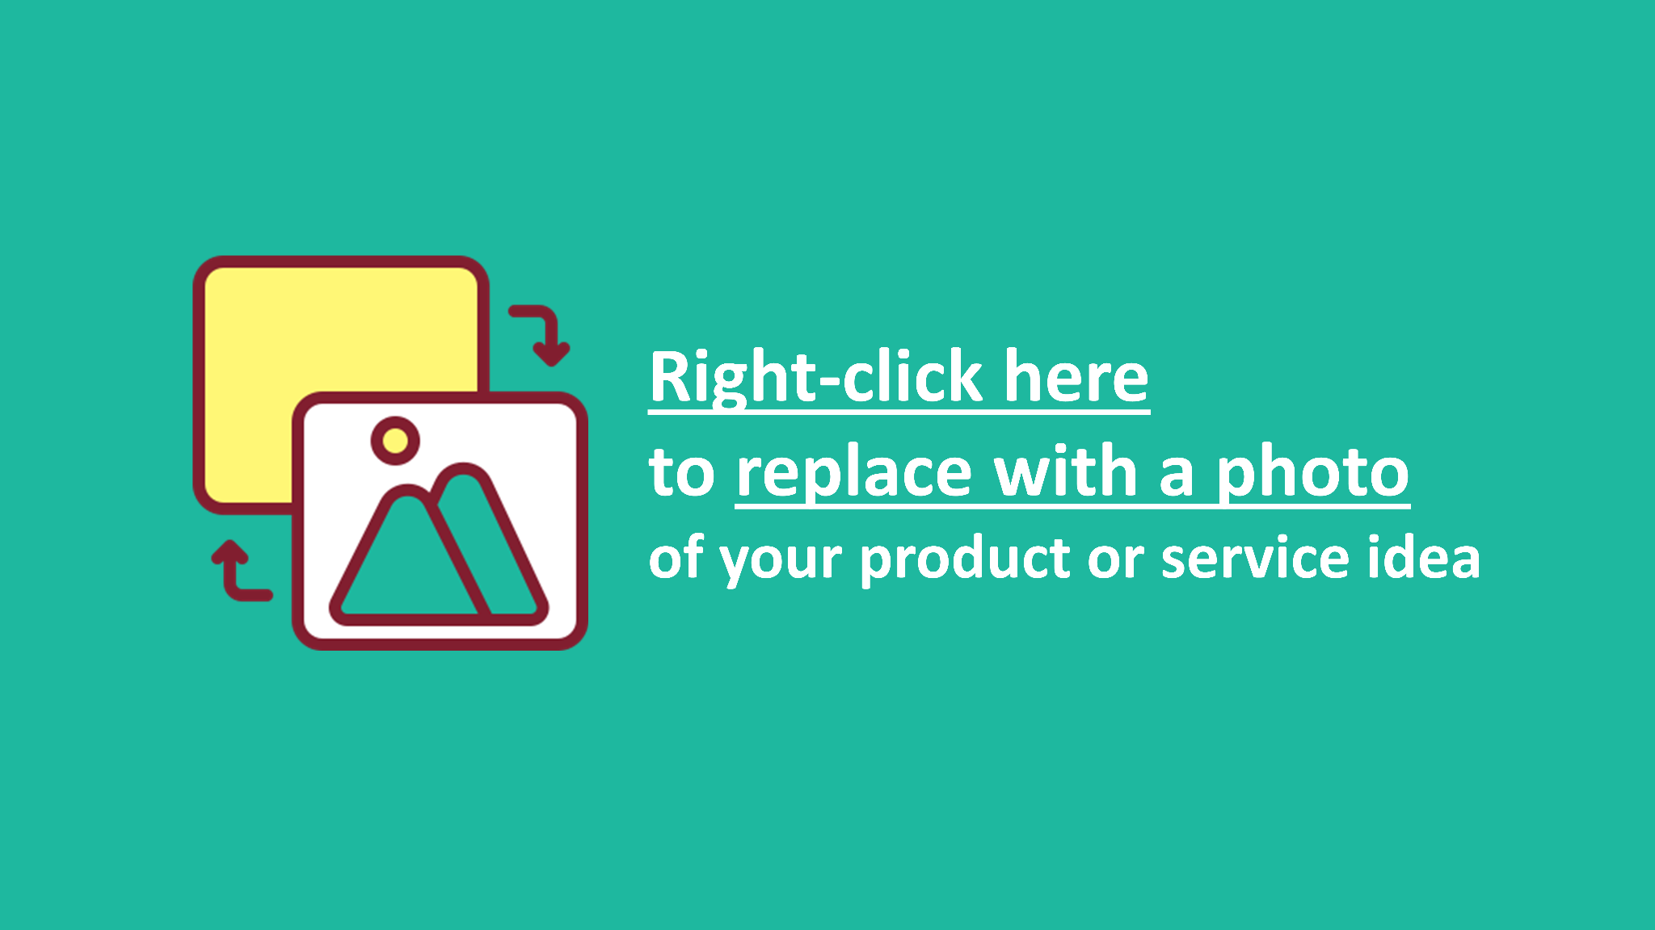
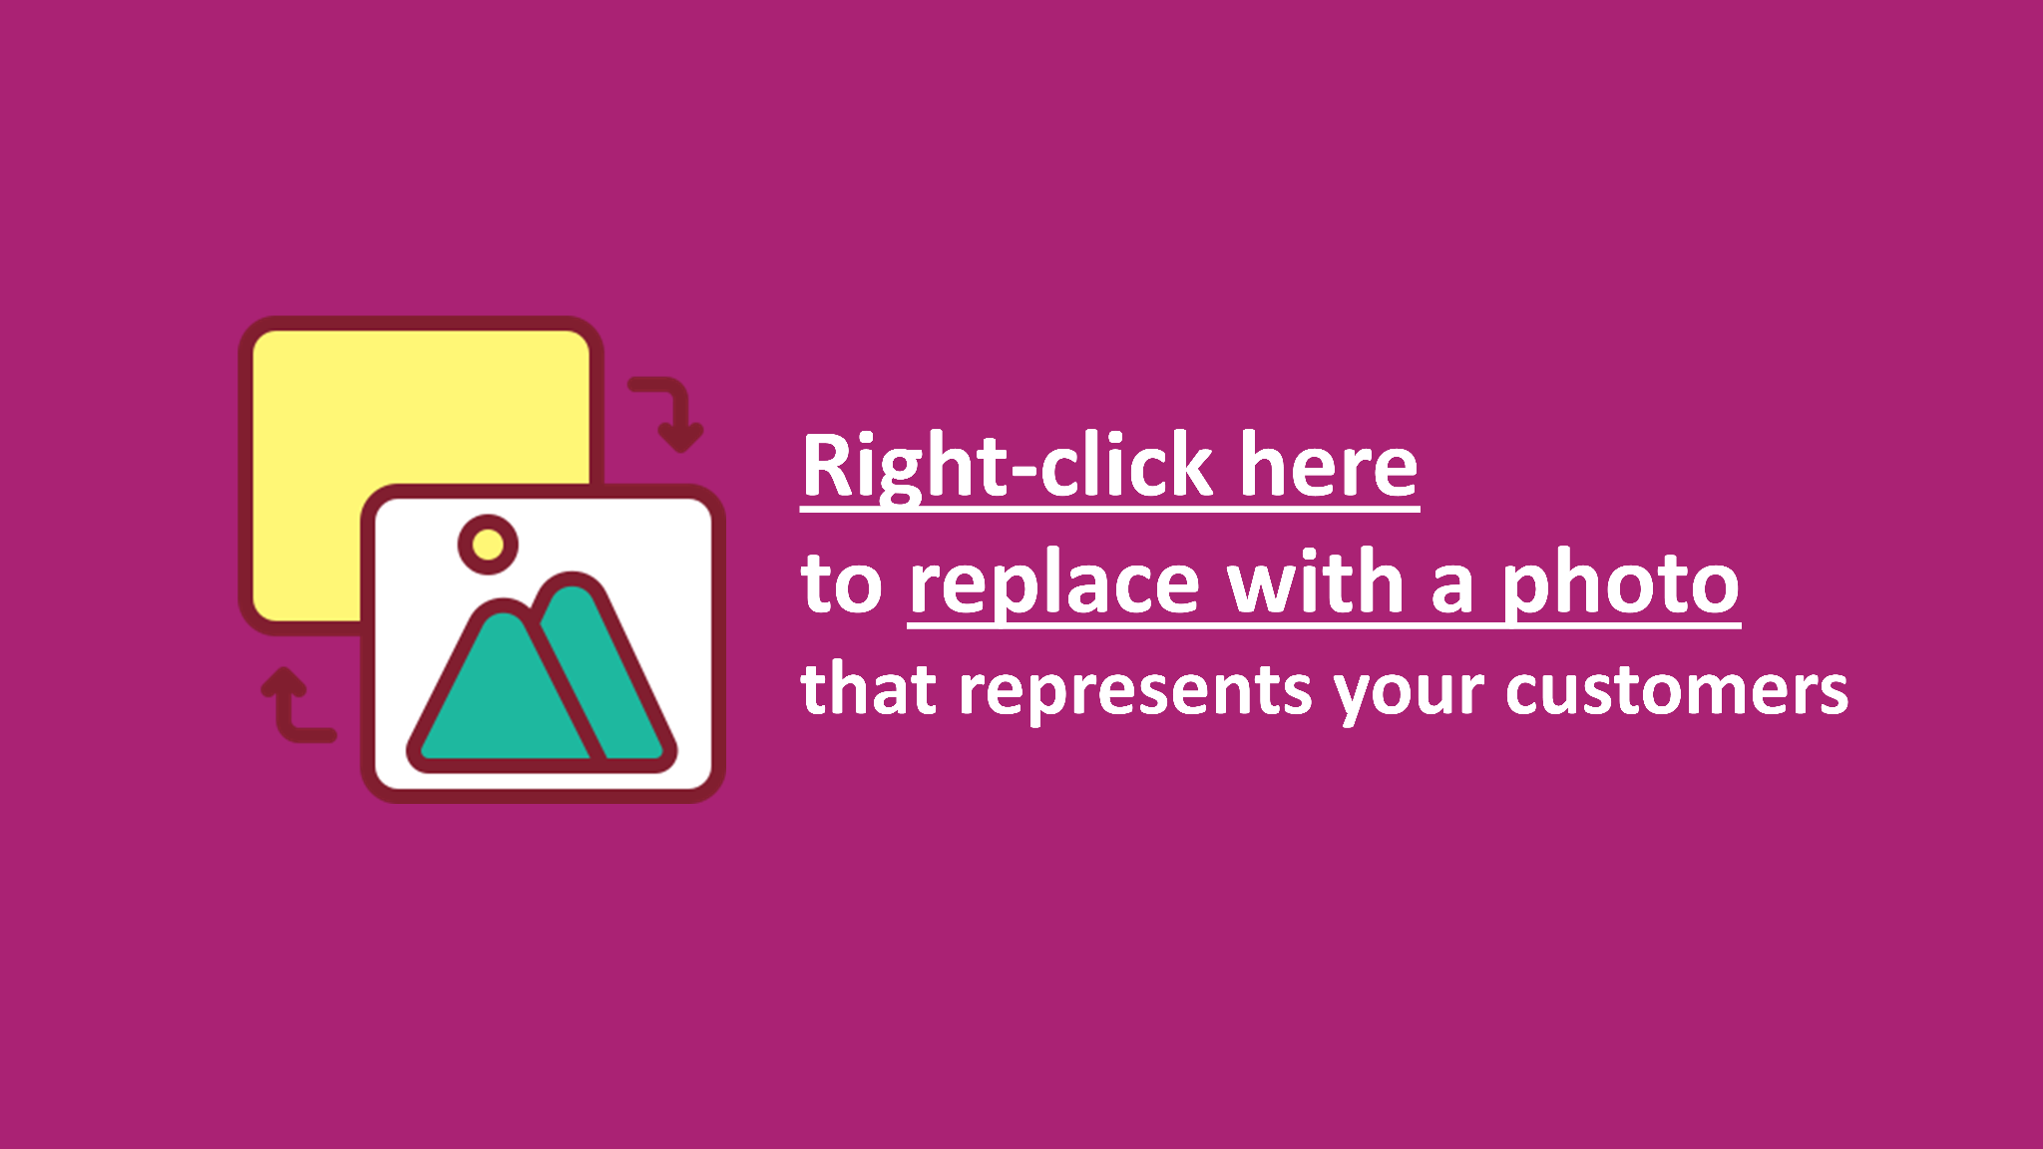

My idea
About my customers
My big vision
My idea:
Replace this text, writing in two sentences what your product or services idea is in a simple way that everybody can understand.
My customers:
Replace this text, writing in one to two sentences who will be your customers/users.
🔭My big vision:
Replace this text, writing in two sentences where you want your business to be in 5 years from now.
What makes it unique:
Replace this text, writing in one or two sentences what makes your product special / unique.
My customers problem Replace this text, writing in one sentences what problem you are solving for the customer.
🧗🏽‍♂️My next steps:
Replace this text, writing in one or two sentences what your next steps are and what help you need.
Notes:
On this slide, you will present your idea, your target customers and your big vision & next steps for making your idea real.
What is your product / service idea?
What features make it unique (USPs) compared to competitors’?
Who are your target customers and what is the problem you want to solve for them with your product or service
What are your next steps in creating a business from your idea?
What could the pitch audience do to help you with those next steps?

Slide 4

Copyright
Conditions of use
This content is free to use for individuals.
It is also free to use for organisations who deliver services free of charge to end users.
Commercial use of this content (other than by the copyright holders) is prohibited.
If you are interested in modifying, translating or localising the Better Futures content, please fill in this online form bit.ly/better_futures_collab.
The project coordinators will be in touch with you to discuss your involvement.

